Slide 1
Semantic Parsing Tools
GYN

Slide 2
Contents
Broad-Coverage Semantic Parsing (SDP).
UCCA
AMR

Slide 3
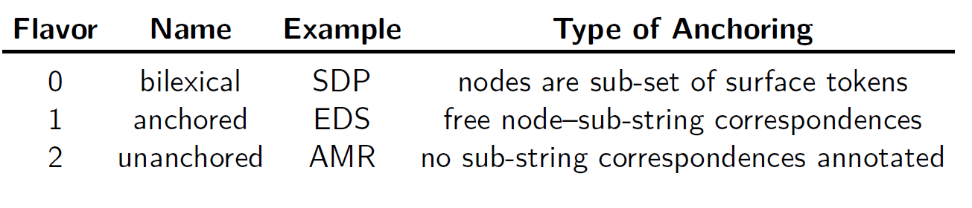
Preview
Abstract Meaning Representation(AMR): encodes sentence-level semantics, such as predicate-argument information, reentrancies, named entities, negation and modality, into a rooted, directed, and usually acyclic graph with node and edge labels. AMR graphs abstract away from syntactic realizations, i.e., there is no explicit correspondence between elements of the graph and the surface utterance. Different sentences with same meaning should have the same AMR
Semantic Dependency Parsing(SDP): Their annotations have been converted into bi-lexical dependencies, forming directed graphs whose nodes injectively correspond to surface lexical units, and edges represent semantic relations between nodes (DM, PAS, PSD), word-level dependency parsing
Universal Conceptual Cognitive Annotation(UCCA): targets a level of semantic granularity that abstracts away from syntactic paraphrases in a typologically motivated, cross-linguistic fashion. Sentence representations in UCCA are directed acyclic graphs (DAG), where terminal nodes correspond to surface lexical tokens, and non-terminal nodes to semantic units that participate in super-ordinate relations. Edges are labeled, indicating the role of a child in the relation the parent represents. world-level semantic relations

Slide 4
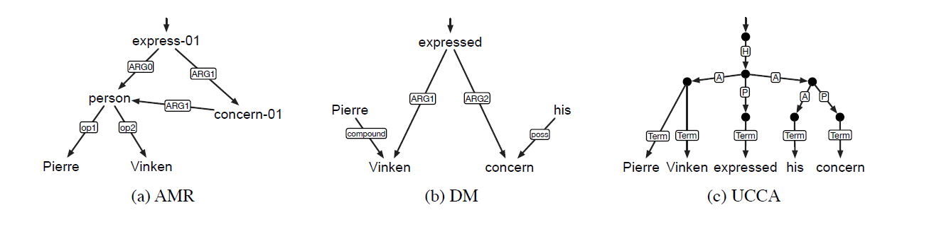
Preview
“Pierre Vinken expressed his concern”.

Slide 5
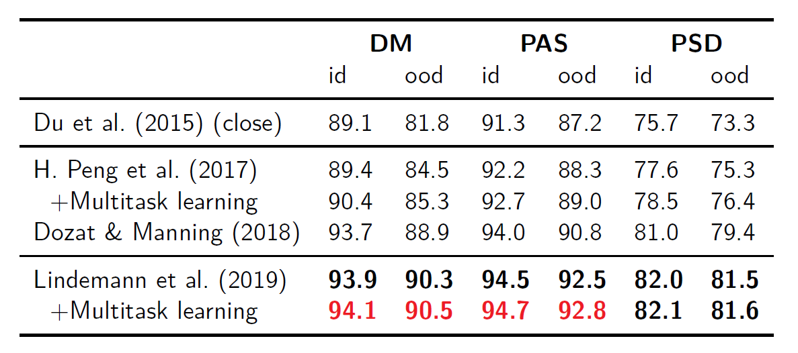
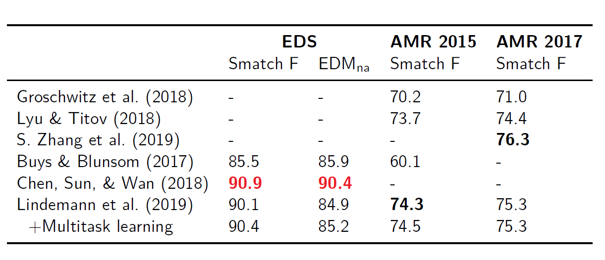
Preview

Slide 6
Parsing Tools
Broad-Coverage Semantic Parsing.
UCCA
TAPU
AMR
JAMR
AMREager

Slide 7
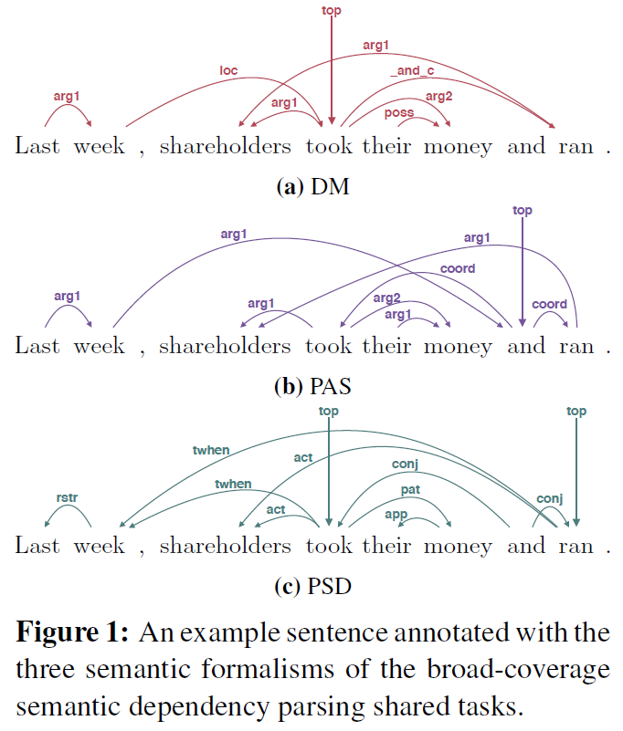
SDP: Broad-Coverage Semantic Dependency Parsing
First defined in a SemEval 2014 shared task (Oepen et al., 2014), and then extended by Oepen et al. (2015), the broad-coverage semantic depency parsing (SDP) task is centered around three semantic formalisms whose annotations have been converted into bilexical dependencies.
目前看到一个parser,不过好像不可以直接生成图，这个代码的环境一直配的有一点问题
https://github.com/Noahs-ARK/NeurboParser
[ Deep multitask learning for semantic dependency parsing; ACL 2017]

Slide 8
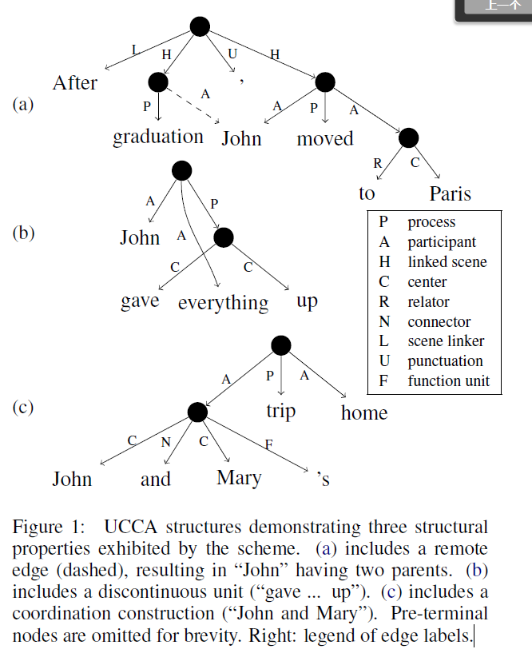
UCCA
“After graduation, John moved to Paris”
two scenes, whose main relations
“graduation”
“moved”.
“John” is a Participant in both scenes, while “Paris” only in the latter.
UCCA & Syntactic Parsing
Non-verbal predicates in UCCA are represented like verbal ones, such as when they appear in copula clauses or noun phrases. Indeed, in Figure 1a, “graduation” and “moved” are considered separate events, despite appearing in the same clause.
In the same example, “John” is marked as a (remote) Participant in the graduation scene, despite not being overtly marked.
Consider the possessive construction in Figure 1c. While in UCCA “trip” evokes a scene in which “John and Mary” is a participant, a syntactic scheme would analyze this phrase similarly to “John and Mary’s shoes”.

Slide 9
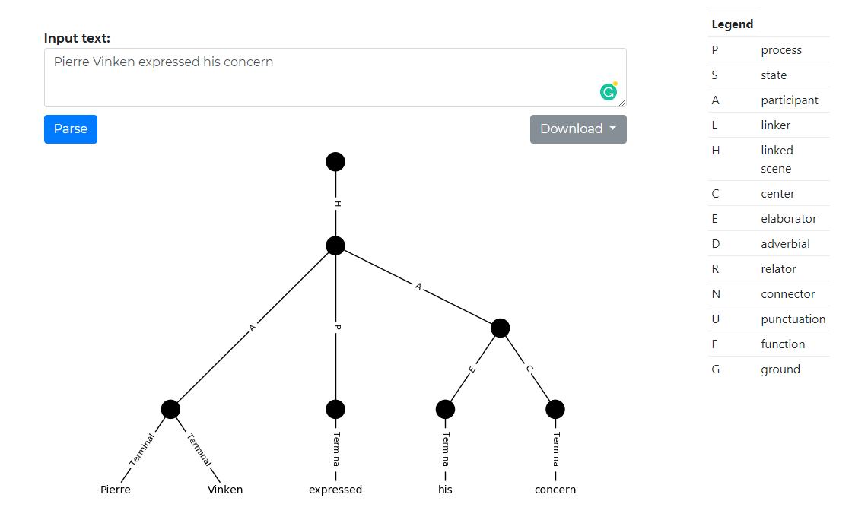
TAPU(Transition-based UCCA Parser),)
DEMO
Github
基于python, 给出图的xml表示
transition-based UCCA parser
A transition-based directed acyclic graph parser for UCCA[J]. 2017.
Multitask parsing across semantic representations[J]. 2018.

Slide 10
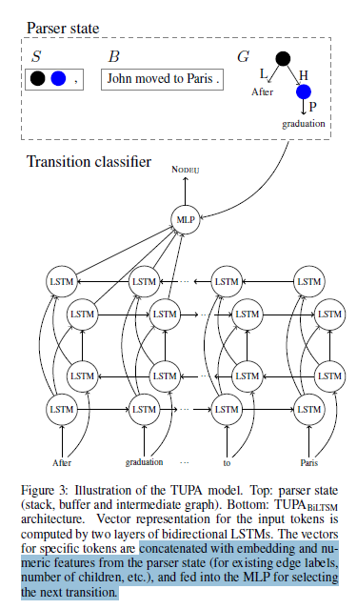
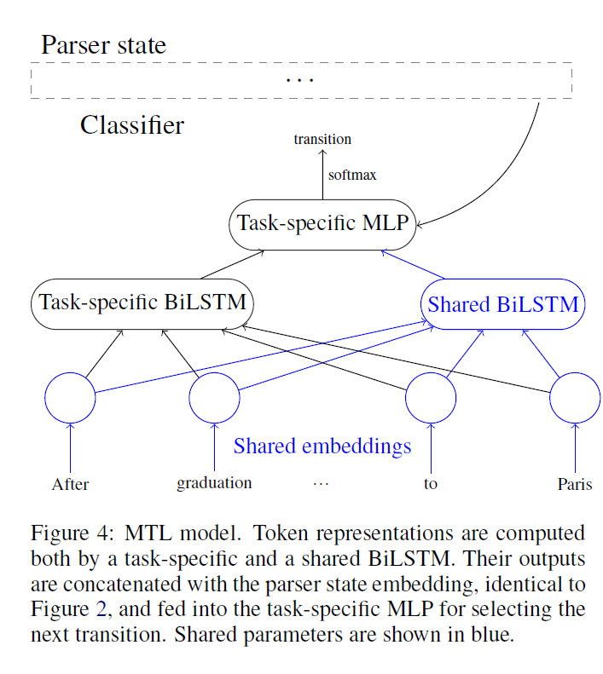
TAPU (Transition-based UCCA Parser)
Transition-based parsers (Nivre, 2003) scan the text from start to end, and create the parse incrementally by applying a transition at each step to the parser’s state, defined using three data structures:
a buffer B of tokens and nodes to be processed,
a stack S of nodes currently being processed,
a graph G = (V,E, l) of constructed nodes and edges, where V is the set of nodes, E is the set of edges, and l: E ->L is the label function, L being the set of possible labels.
Some states are marked as terminal, meaning that G is the final output.
A classifier is used at each step to select the next transition based on features encoding the parser’s current state.

Slide 11
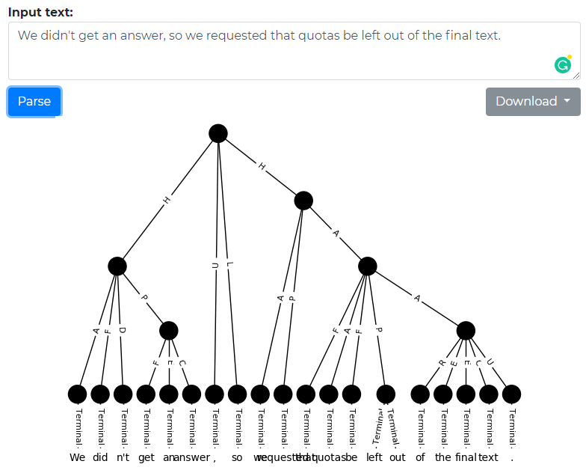
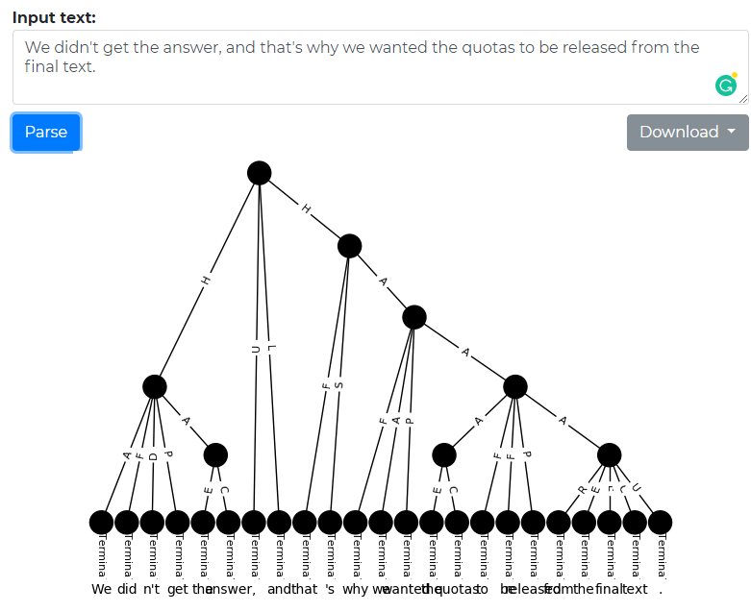
TAPU
Human:0.5077
Ref
Sys

Slide 12
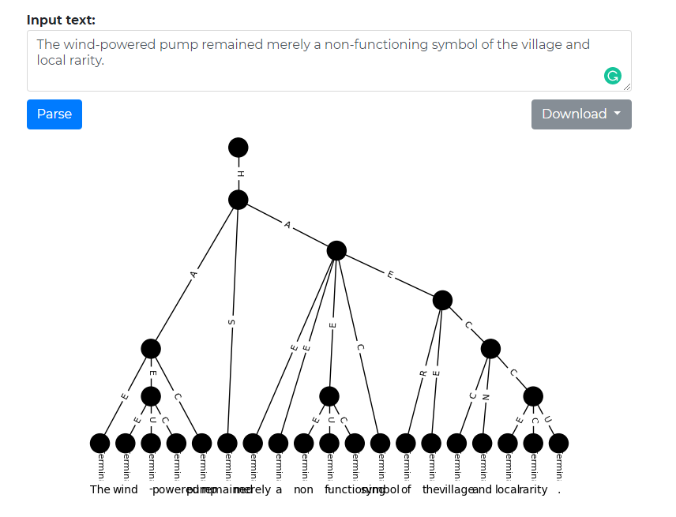
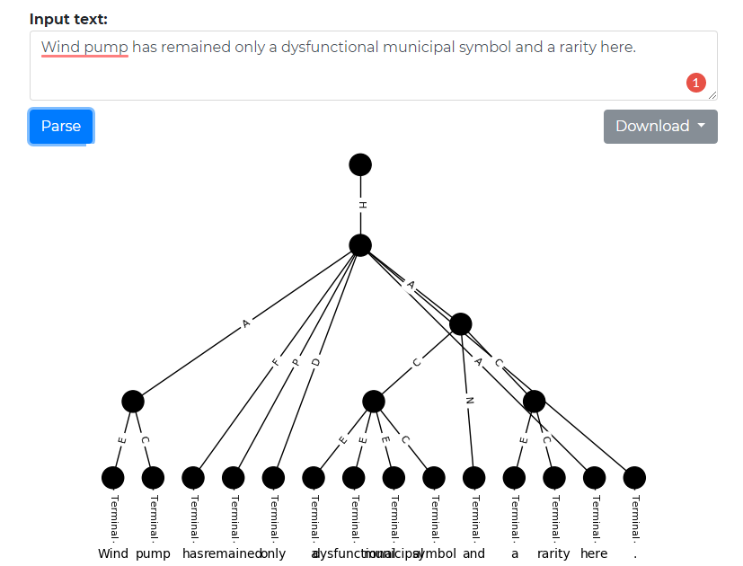
TAPU
Human:0.066
Ref
Sys

Slide 13
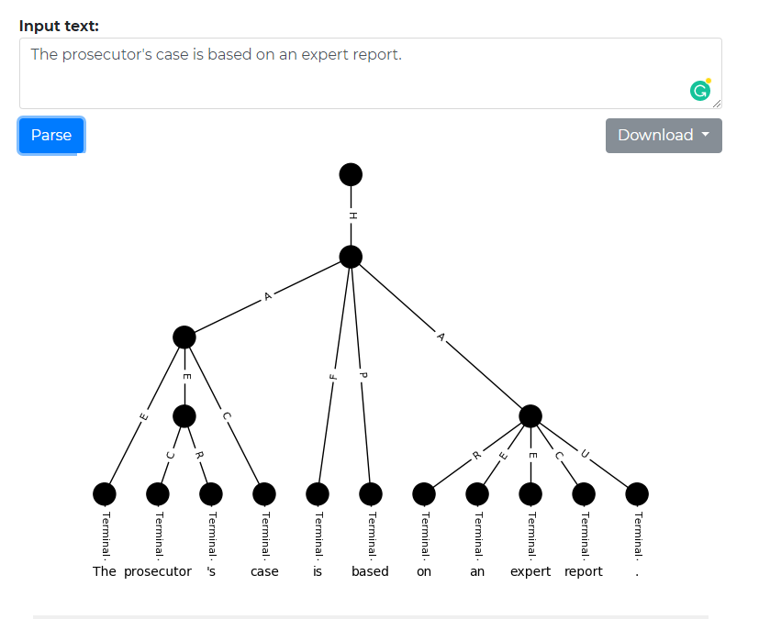
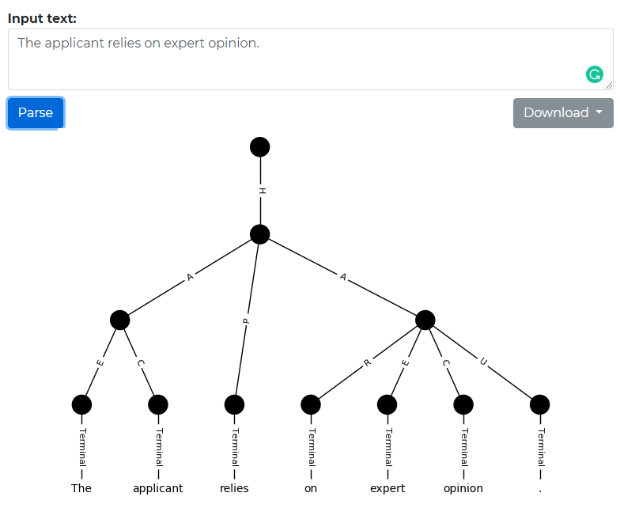
TAPU
Human:-0.378
Ref
Sys

Slide 14
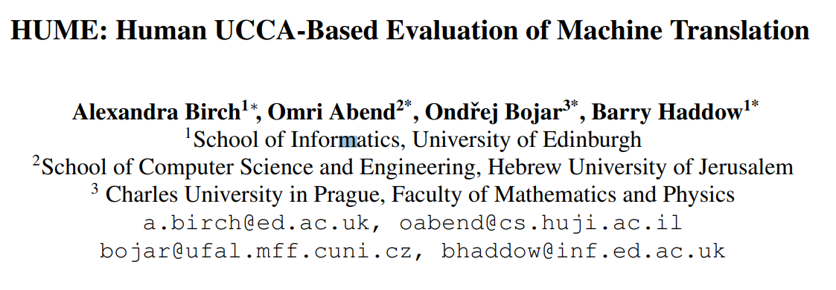
UCCA for MTE

Slide 15
HUME
UCCA’s foundational layer can be annotated by non-experts after a short training
UCCA is cross-linguistically applicable, seeking to represent what is shared between languages by building on linguistic typological theory
the scheme has been shown to be stable across translations: UCCA annotations of translated text usually contain the same set of relations. UCCA reflects a layer of representation that in a correct translation is mostly shared between the translation and the source.

Slide 16
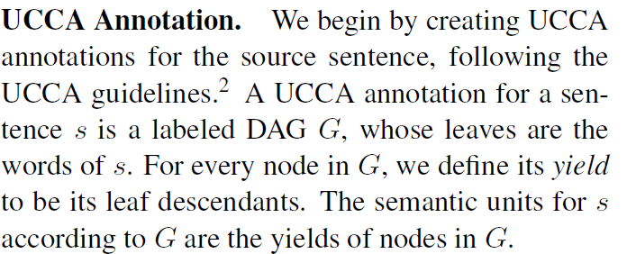
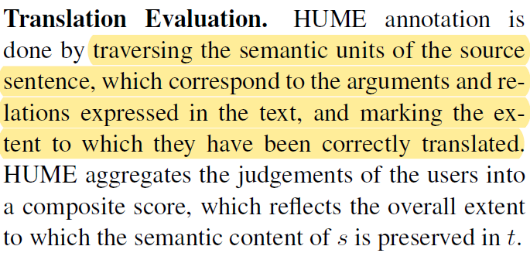
HUME
We denote the source sentence as s and the translation as t.
Procedure:
UCCA-annotating s
HUME-annotation: human judgements as to the translation quality of each semantic unit of s relative to t, where units are defined according to the UCCA annotation

Slide 17
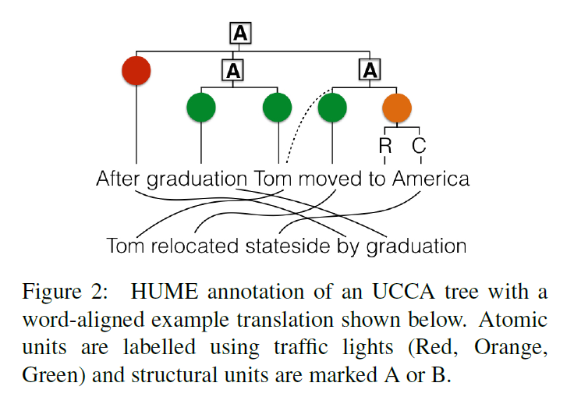
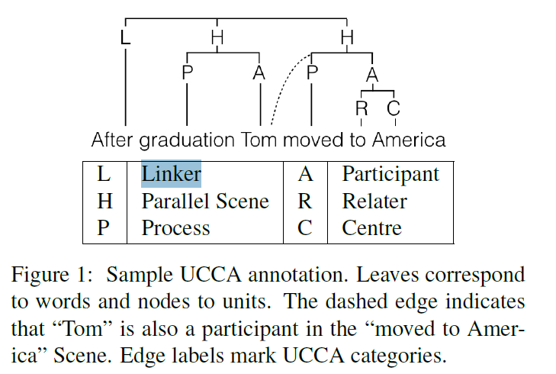
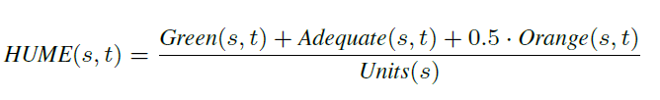
HUME
Green(G, correct),
Orange(O, partially correct)
Red (R, incorrect).<“After” is translated incorrectly as “by” which changes the meaning of the entire sentence>
Structural units are labeled as “Adequate” (A) or “Bad” (B), meaning that the relation between the sub-units went wrong
(Aliments are automatically derived.)

Slide 18
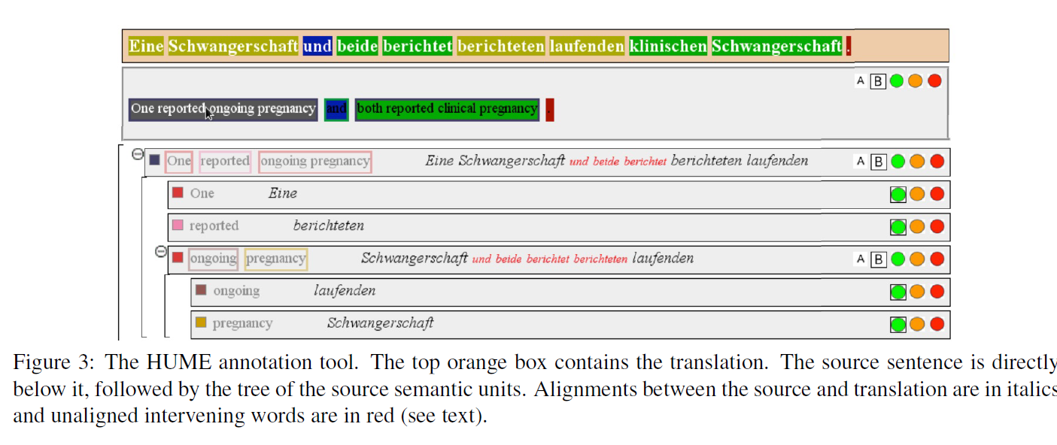
HUME

Slide 19
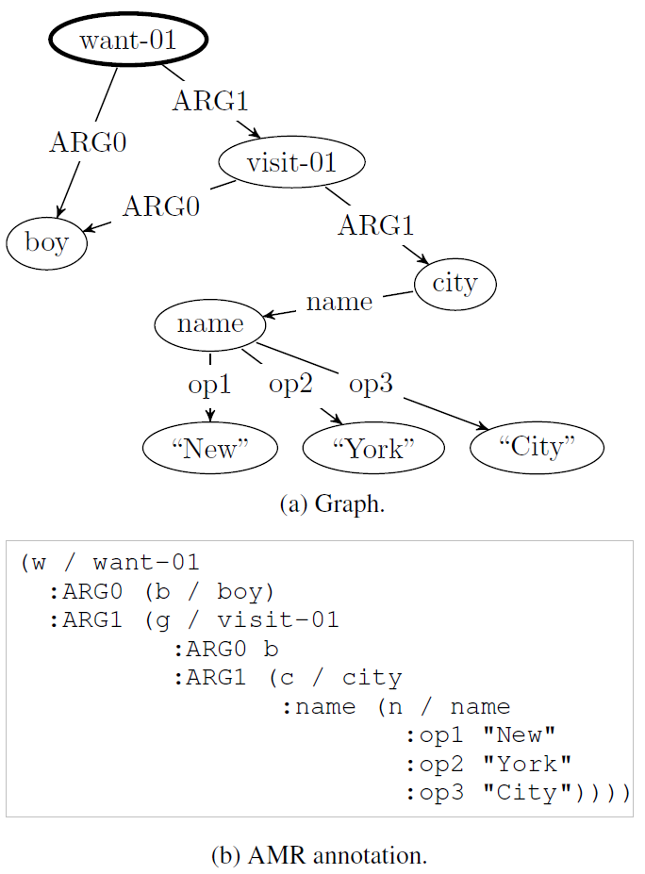
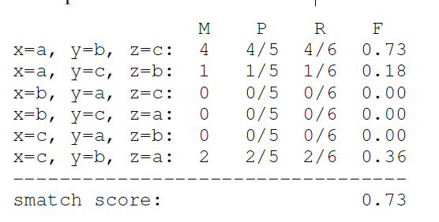
AMR
AMR BANK
AMR format
Evaluation: Smatch Score

Slide 20
JAMR
https://github.com/jflanigan/jamr
A Discriminative Graph-Based Parser for the Abstract Meaning Representation; ACL2014
Output format:
AMR format
Alignment info[具体词和AMR中的sub-graph的对应关系]
Nodes and Edges info
Method:
novel algorithm for finding a maximum spanning, connected subgraph, embedded within a Lagrangian relaxation of an optimization problem that imposes linguistically inspired constraints.
identifies concepts using a semi-Markov model and then identifies the relations that obtain between these by searching for the maximum spanning connected subgraph (MSCG) from an edge-labeled, directed graph representing all possible relations between the identified concepts

Slide 21
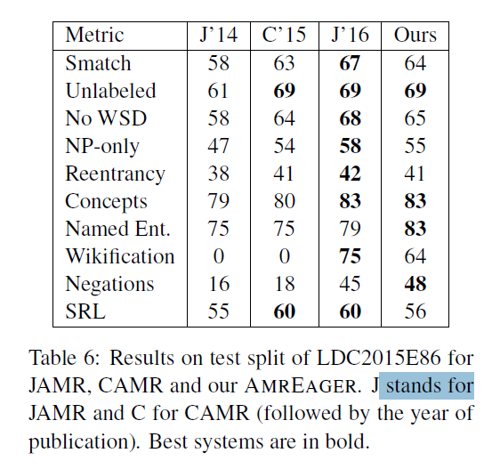
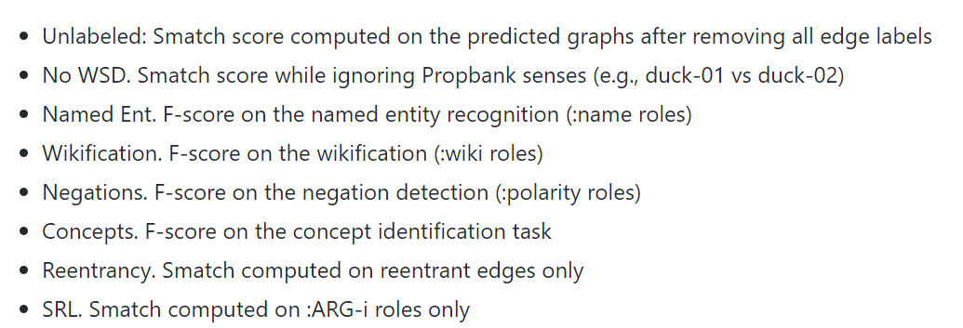
AMR-eager
transition-based parser for AMR that parses sentences left-to-right, in linear time
Code: https://github.com/mdtux89/amr-eager
Demo: http://cohort.inf.ed.ac.uk/amreager.html

Slide 22
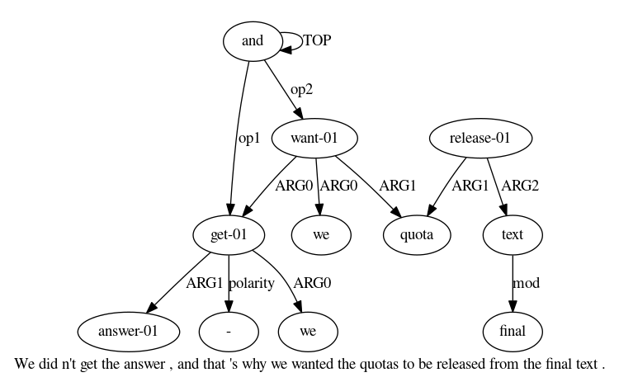
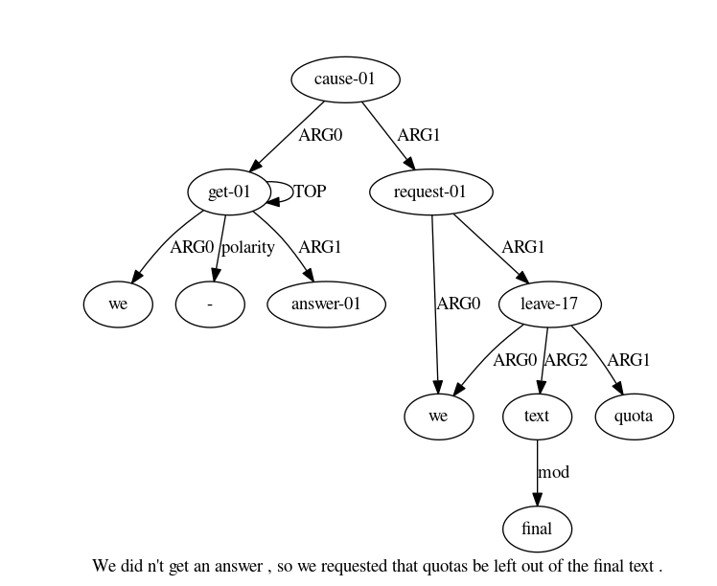
Amr-eager
Human:0.5077
Ref
Sys

Slide 23
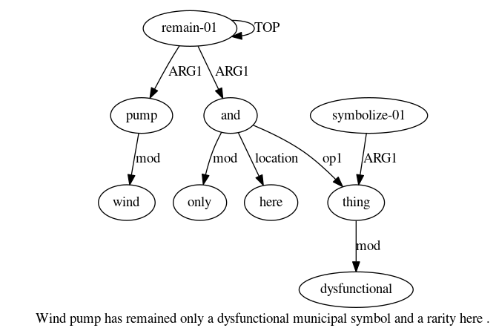
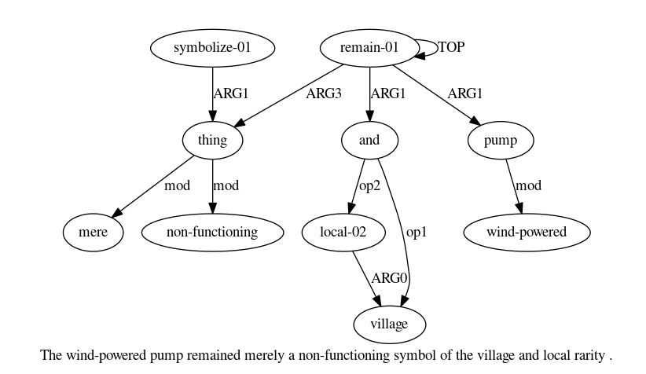
Amr-eager
Human:0.066
Ref
Sys

Slide 24
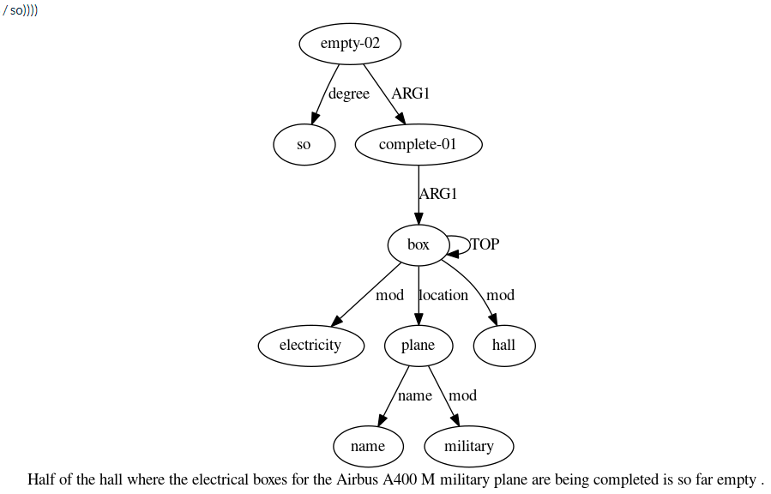
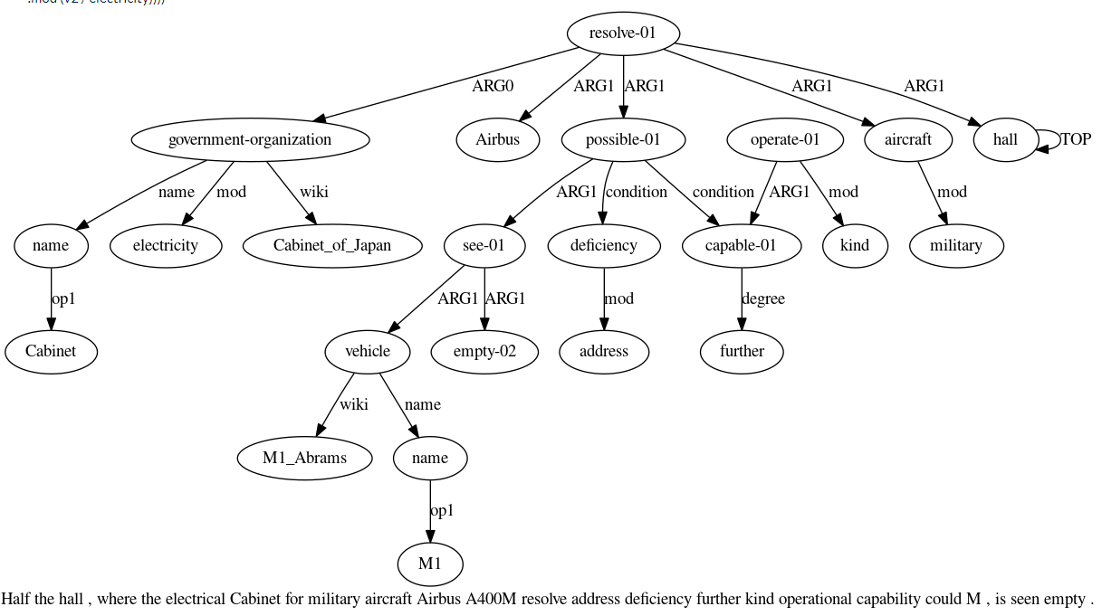
Amr-eager
Human:-0.683
Ref
Sys

